Slide 1
AI-Systems Machine Learning Frameworks
Joseph E. Gonzalez
Co-director of the RISE Lab jegonzal@cs.berkeley.edu

Slide 2
Objectives For Today
Historical Evolution of Machine Learning Frameworks
Declarative (Lazy) vs Imperative (Eager) DSLs
Automatic Differentiation
This weeks reading

Slide 3
Historical Context

Slide 4
Early ML / Stats Languages
S Data Programming Languages
Developed in 1976 as Bell Labs by John Chambers
Replaced Fortran by providing higher level APIs, graphics
Developed formula syntax for describing models
Eventually replaced by R …
R open-source implementation of S (S-Plus)
Developed in 1990’s at University of Auckland
Ross Ihaka, Robert Gentleman
Like S/S-Plus → Linear algebra abstractions
Rich set of libraries for statistical analysis
Still widely used

Slide 5
Early ML / Stats Languages
Matlab (Matrix Laboratory) – Numerical Computing Sys.
Developed in 1970s at the University of New Mexico by Cleve Moler
Designed to simplify access to LINPACK and EISPACK
Reasonable integration with C/Fortran
Rich graphical interface with support for graphical programming
Simulink
Expensive → Octave limited open-source version
Popular in applied math, engineering, and controls community
Extremely popular in the machine learning community
We would joke that ML people only knew how to program Matlab
and then it all changed …

Slide 6
Rise of the Python Eco-System
Development of %pylab
iPython (2001) + SciPy (2001) + Matplotlib (2003) + NumPy (2006)
Functions /APIs were like Matlab so easy to transition
Freeeeeee!
Scikit-learn – basic ML algorithms and models (2007)
Started as Google summer of code project → developed by INRIA
Wide range of standard machine learning techniques
~2012 large fraction of ML community Matlab → Python
Why?
Development remained focused on algorithms libraries

Slide 7
Machine Learning Libraries
LIBLINEAR/LIBSVM (2008) – fast algorithms for fitting linear models and kernelized SVMs
Developed at National Taiwan University for (still used in Sklearn)
Vowpal Wabbit (2010?) – out-of-core learning for generalized linear models and others
Developed by John Langford while at Yahoo!
Popular for high-dimensional features
Weka (Java version 1997) – Collection of ML algorithms for Java
Developed at the University of Waikato in New Zealand
Provided tools for visualizing and analyzing data
Xgboost (2014) – distributed boosted decision trees
Developed by Tianqi Chen at University of Washington
Many more …

Slide 8
Distributed Machine Learning Frameworks
Mahout (2009) – ML algorithms on Hadoop
Early distributed ML library with “recommender algorithms”
Unable to leverage memory caching
GraphLab (2010) – Framework for graph structured algorithms
Contained library of algs. (e.g., Gibbs Sampling, LoopyBP, …)
Developed new abstractions for distributed graph algs.
Spark mllib / SparkML (2014) – ML algorithms for Spark
Leverages memory caching
Benefits from work on GraphLab/Sklearn/SystemML

Slide 9
Languages vs Algorithm Libraries
Languages
(R/Matlab)
Pipeline
(embedded)
DSLs
Libraries of Algorithms
Generality
Simplicity
Languages provided support for mathematical operations
User still implemented new models and algorithms using fundamental linear algebra primitives
Libraries of Algorithms provided individual learning techniques
Often specialized to model/technique (fast and easy-to-use)
Need something in the middle!

Slide 10
Embedded Domain Specific Languages
Domain specific languages (DSLs) provide specialized functionality for a given task
Limited functionality → simplicity and optimization
Example: SQL → Specialized for data manipulation
Embedded DSLs are libraries or language extensions within a general-purpose language tailored to a specific task
Combine benefits of DSL and general languages
Example: linear algebra libraries
Embedded DSLs have played a significant role in ML
Linear Algebra → Pipelines → Differentiable Programs

Slide 11
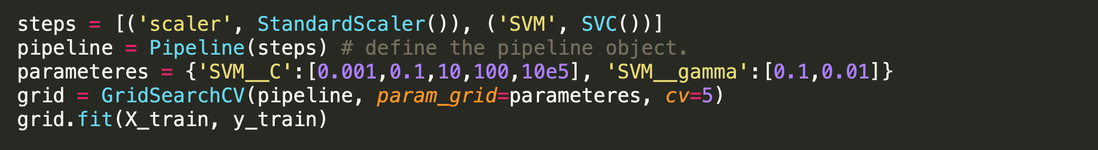
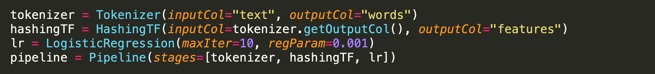
Machine Learning Pipelines
Scikit Learn Pipelines (2011)
Describes composition of feature transformations and models
Enables end-to-end training and standardized prediction
Spark ML Pipelines (Similar to SkLearn)

Slide 12
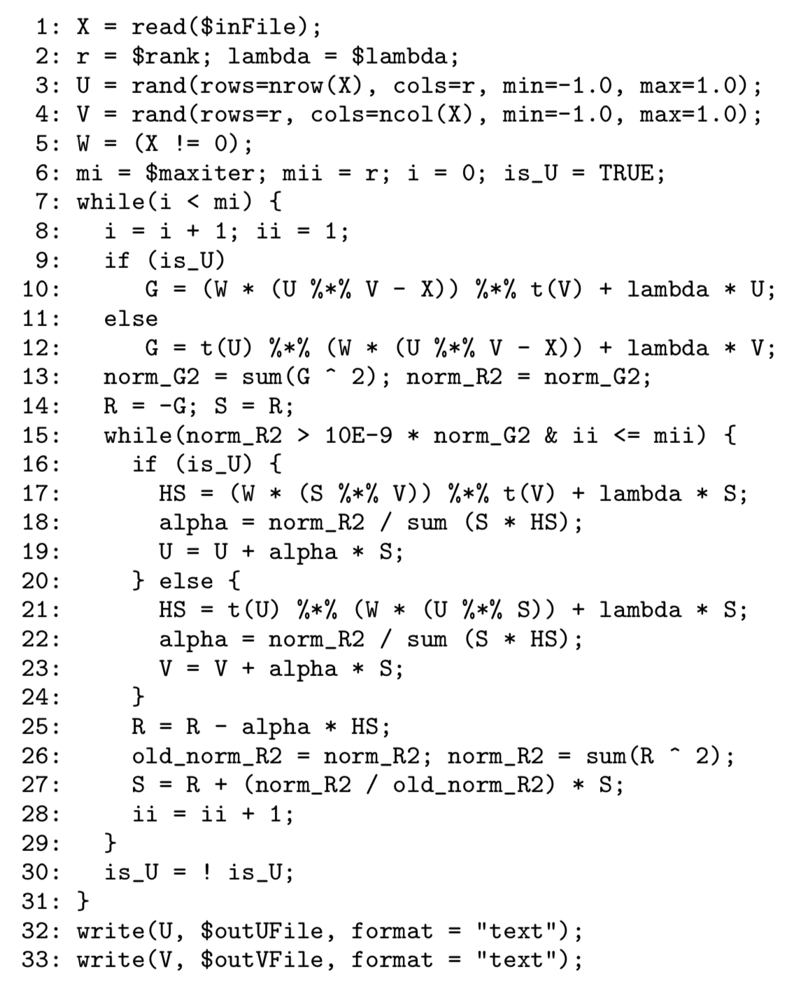
SystemML (VLDB’16)
Developed at IBM
Domain specific language for describing ML algorithms
Python/R like but not embedded
Optimizer and runtime to execute on Apache Spark
Explored range of optimizations
Data repartitioning
Caching
Distributed matrix representations

Slide 13
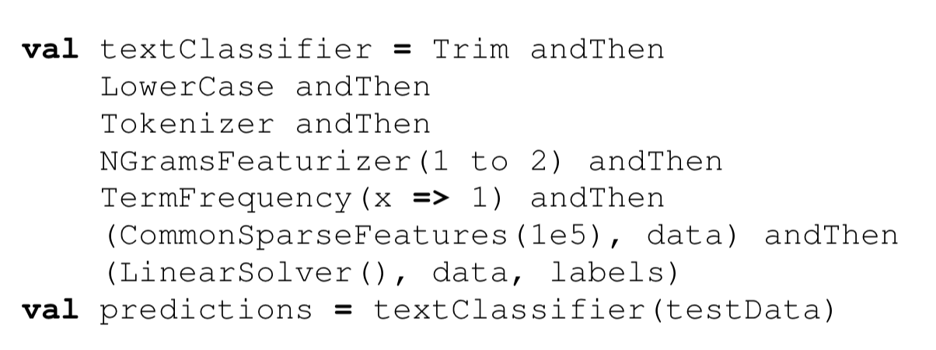
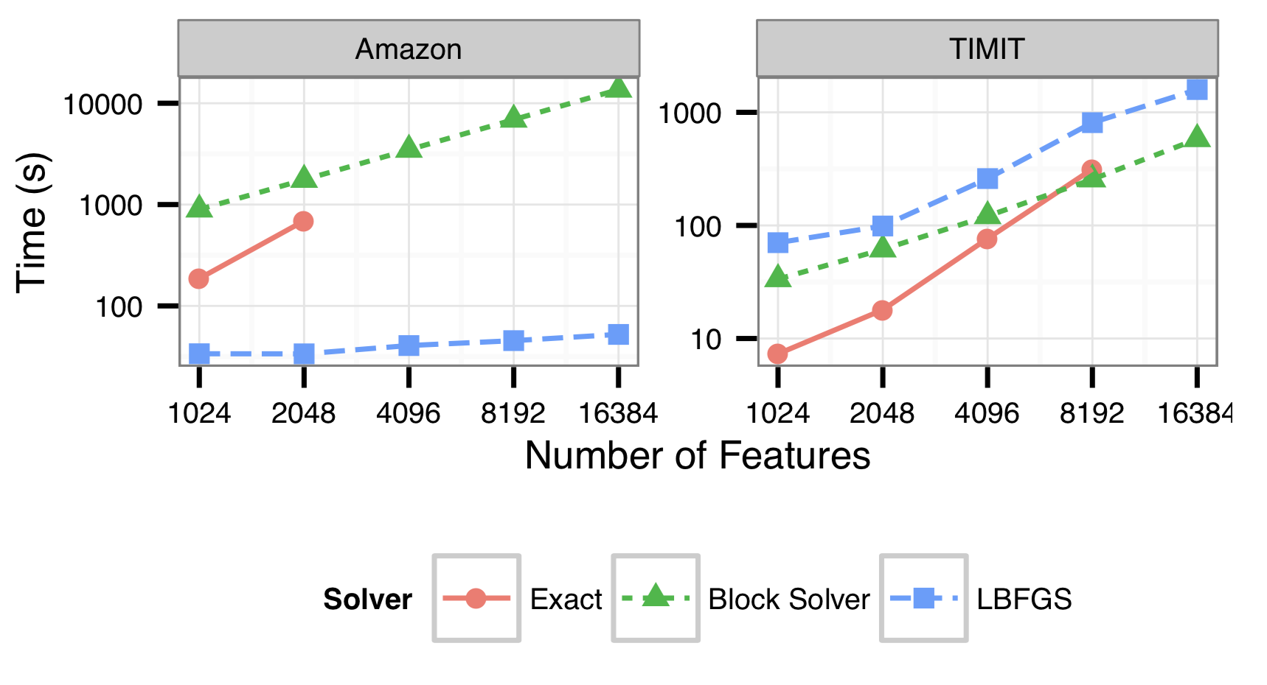
Keystone ML (ICDE’17)
Developed in AMPLab@Berkeley
Pipelines of ML algorithms and optimization on top of Spark
Embedded Scala DSL
Outperformed SystemML
Cost based optimize to select best version of learning algorithm based on inputs
Example: QR vs L-BFGS

Slide 14
Languages vs Algorithm Libraries
Languages
(R/Matlab)
Embedded DSLs for Differentiable Programs
Libraries of Algorithms
Pipeline
(embedded)
DSLs
Generality
Simplicity
Increased focus on deep learning → empirical risk minimization for complex differentiable models
Research shifts from algorithm design to model design
Deep Learning Frameworks:Theano (2008), Caffe (2014), MXNet (2015), TensorFlow (2015), PyTorch (2016)
Combine automatic differentiation with hardware acceleration

Slide 15
Review of Automatic Differentiation

Slide 16
Automatic Differentiation
Method of computing numeric derivatives of a program by tracking the forward execution of that program
Other methods for computing derivatives
Manual implementation: the standard method in deep learning prior to these frameworks
laborious and error prone!
Numerical differentiation: using finite differences
Easy, costly and sensitive to numerical precision
Symbolic differentiation: using computer algebraic systems
Expressions can grow exponentially

Slide 17
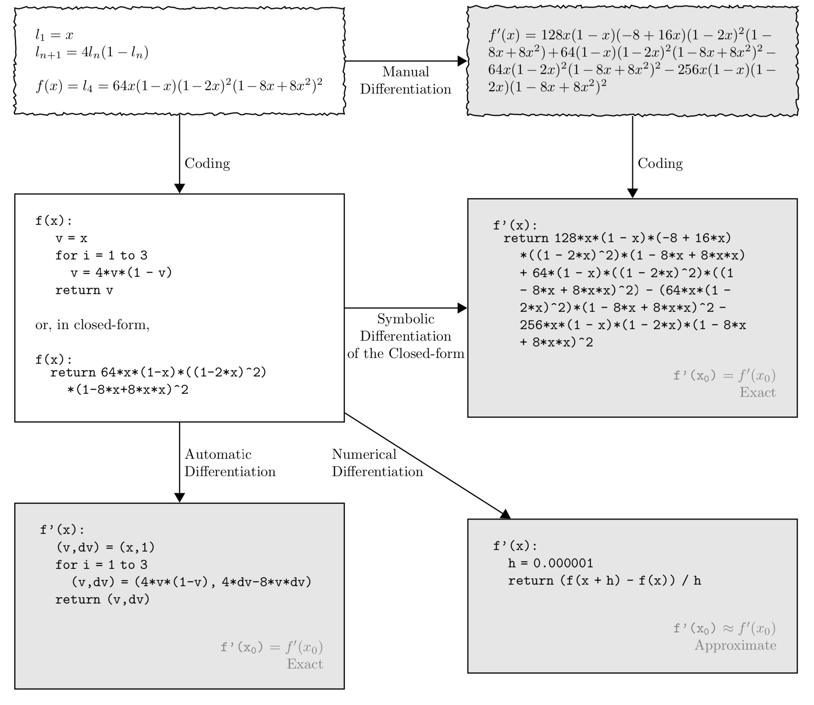
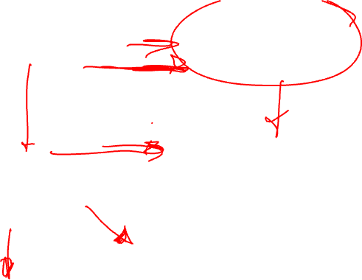
Illustration from “Automatic Differentiation in Machine Learning: a Survey”

Slide 18
Illustration from “Automatic Differentiation in Machine Learning: a Survey”

Slide 19
Illustration from “Automatic Differentiation in Machine Learning: a Survey”

Slide 20
Illustration from “Automatic Differentiation in Machine Learning: a Survey”
How I used to do this as a graduate student (2010).
How I would cheat using Mathematica.

Slide 21
Illustration from “Automatic Differentiation in Machine Learning: a Survey”
Automatic differentiation operates on a program to generate a program that computes the derivative efficiently and accurately.

Slide 22
Key Ideas in Automatic Differentiation
Leverage Chain Rule to reason about function composition
Two modes of automatic differentiation
Forward differentiation: computes derivative during execution
efficient for single derivative with multiple outputs
Backward differentiation (back-propagation): computes derivative (gradient) by reverse evaluation of the computation graph
Efficient for multiple derivative (gradient) calculation + Requires caching

Slide 23
Forward Differentiation (Example)
Goal is to compute:
@

Slide 24
Forward Differentiation (Example)
2
ln(2)
Goal is to compute:
@
x₁
ln
v₁
ln(2) + 10
Ln(2) + 10 – sin(5)
+
v₄
-
v₅
10
*
v₂
5
sin(5)
Notice that only last results need to be stored
Would need to repeat for x₂
x₂
sin
v₃

Slide 25

Backward (Reverse) Differentiation
2
ln(2)
Goal is to compute:
@
x₁
ln
v₁
ln(2) + 10
Ln(2) + 10 – sin(5)
+
v₄
-
v₅
10
*
v₂
5
sin(5)
x₂
sin
v₃

Slide 26

Backward (Reverse) Differentiation
Performs well when computing large gradients relative to number of function outputs
When might forward differentiation perform well? Why?
Requires caching or recomputing intermediate activations from forward pass
Active research on what to recompute vs cache
x
Loss
g
g
g

Slide 27
Deep Learning Frameworks

Slide 28
Declarative vs Imperative Abstractions
Declarative (define-and-run): Embedded DSL used to construct static computation graph
Examples: Theano (2010), Caffe (2014), TensorFlow (2015)
Easier to optimize, distribute, and export models
Imperative (define-by-run): Embedded DSL used to directly compute output resulting in a dynamic computation graph defined by the program
Examples: Chainer (2015), autograd (2016), PyTorch (2017)
Interpreted execution of inference and gradient
Easier to program and debug
Hybrid Approaches: Current research
TensorFlow Eager, MXNet

Slide 29
Theano – Original Deep Learning Framework
First developed at the University of Montreal (2008)
from Yoshua Bengio’s group
Abstraction: Python embedded DSL (as a library) to construct symbolic expression graphs for complex mathematical expressions
System: a compiler for mathematical expressions in Python
Optimizes mathematical expressions (e.g., (A+b)(A+b)=(A+b)^2)
CPU/GPU acceleration
Also … automatic differentiation

Slide 30
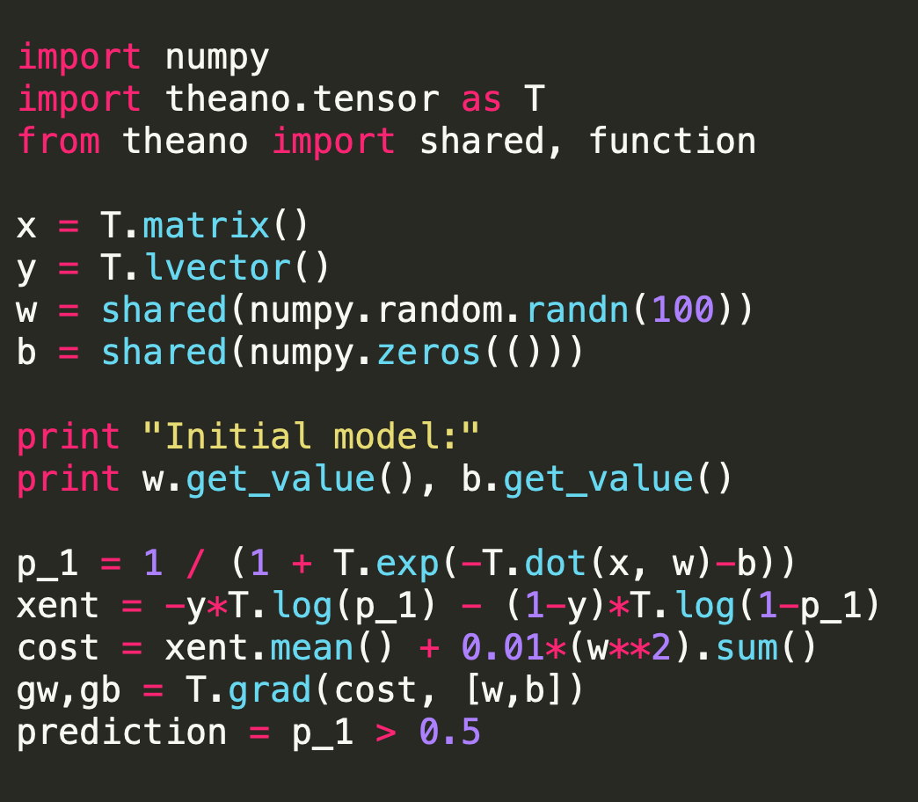
x
y
w
b
Declaring Variables
dot
-
log
-1*
1-
1-
exp
*
log
1+
*
1/
-
**2
p_1
xent
Building Expression Graph
Note that this looks like a NumPy expression
0.01*
What is the value (type) of prediction?
Mean
Sum
Gradient operation can traverse graph
This is more difficult to debug and reason about.
+
Cost

Slide 31
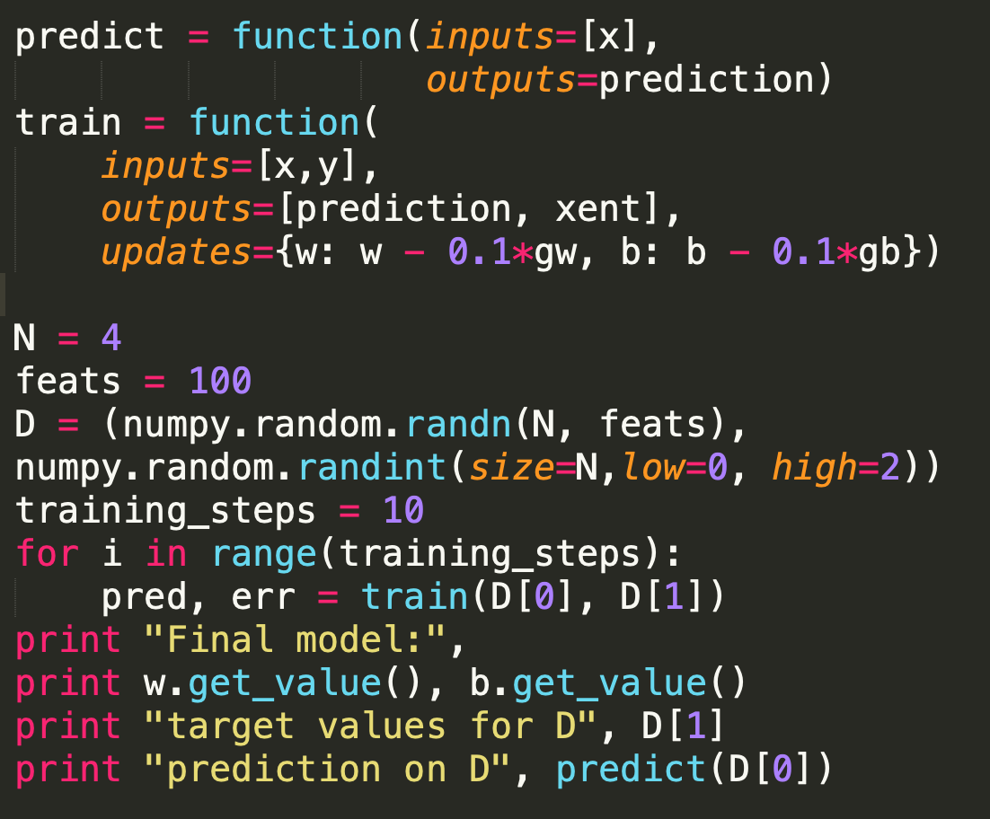
Declaring Variables
Updates shared variables after computation
Instantiating
Values
Building Expression Graph
Note that this looks like a NumPy expression
What is the value (type) of prediction?
Function call compiles graphs into optimized native execution.
This is more difficult to debug and reason about.

Slide 32
Theano Compilation of Functions
Canonicalization
Stabilization
Specialization
GPU Transfer
Code Generation
Rewriting (simplify) mathematical expression
Exp(log(x)) = x
Duplicate code elimination
Important because gradient rewrites introduce redundancy
Recall gradient calculations extend graph via the chain rule

Slide 33
Theano Compilation of Functions
Canonicalization
Stabilization
Specialization
GPU Transfer
Code Generation
Addresses numerical stability of operations
Example: for x = 709, x = 710 what is the value of
log(1 + exp(x)) =
for x = 709 ➔ 709
for x = 710 ➔ inf
Rewritten as x for x > 709

Slide 34
Theano Compilation of Functions
Canonicalization
Stabilization
Specialization
GPU Transfer
Code Generation
Rewrite subgraphs to more efficient forms
pow(x,2) → square(x)
Tensor slicing → memory aliasing
Mapping to best version of GEMM routines

Slide 35
Theano Compilation of Functions
Canonicalization
Stabilization
Specialization
GPU Transfer
Code Generation
GPU versions of ops are introduced (where possible)
Copy routines are added to move data

Slide 36
Theano Compilation of Functions
Canonicalization
Stabilization
Specialization
GPU Transfer
Code Generation
Generate and link C++ and CUDA implementations of operators
Picking from existing implementations
Specialization for different dtypes

Slide 37
What happened to Theano?
Fairly advanced compared to TensorFlow (TF) in 2016
Symbolic gradient optimization and wide range of operators
Initially faster than TensorFlow
What happened? (some speculation…)
Didn’t have the backing of a large industrial group
TensorFlow was being pushed heavily by Google
Did not support multi-GPU/distributed computation and limited support for user defined parallelization
TensorFlow had more built-in deep learning operators
Theano lacked visualization tools (e.g., TensorBoard)
Complaints about error messages…?

Slide 38
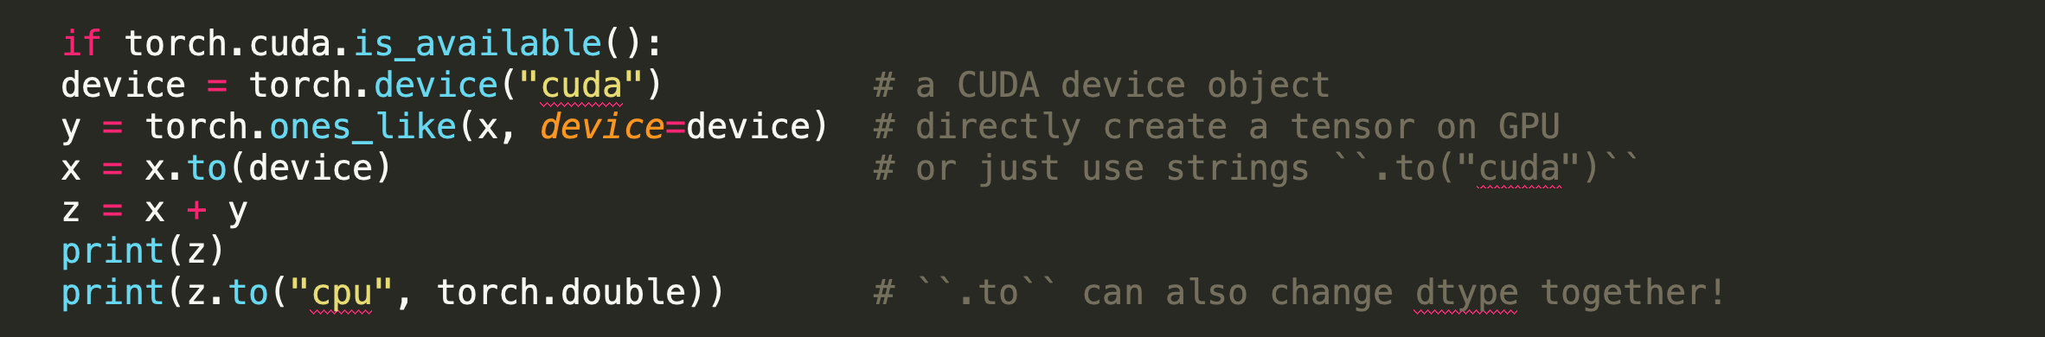
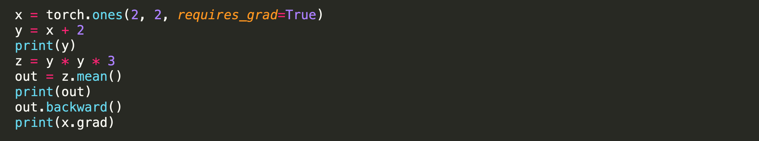
PyTorch
Imperative DL library which works like NumPy (on GPUs)
and supports automatic differentiation
tensor([2.0814], device='cuda:0')
tensor([2.0814], dtype=torch.float64)
# tensor([[3., 3.],
# [3., 3.]], grad_fn=<AddBackward0>)
# tensor(27., grad_fn=<MeanBackward0>)
# tensor([[4.5000, 4.5000],
# [4.5000, 4.5000]])

Slide 39
This weeks readings

Slide 40
Reading for the Week
Automatic differentiation in ML: Where we are and where we should be going
NeurIPS’18
Provides an overview of the state of automatic differentiation
TensorFlow: A System for Large-Scale Machine Learning
OSDI’16
The primary TensorFlow paper discusses system and design goals
JANUS: Fast and Flexible Deep Learning via Symbolic Graph Execution of Imperative Programs
NSDI’19
Recent work exploring a method to bridge Declarative and Imperative approaches in TensorFlow

Slide 41
Extra Suggested Reading
Automatic Differentiation in Machine Learning: a Survey(JMLR’18)
Longer discussion on automatic differentiation in ML
Theano: A CPU and GPU Math Compiler in Python (SciPy’10)
Great overview of AD and Theano system
TensorFlow Eager: A Multi-Stage, Python-Embedded DSL for Machine Learning (arXiv’19)
Good follow-up to TF paper addressing limitations

Slide 42
Automatic differentiation in ML: Where we are and where we should be going?
Bart van Merriënboer, Olivier Breuleux, Arnaud Bergeron, Pascal Lamblin
From Mila (home of Theano) and Google Brain (home of TF)

Slide 43
Automatic differentiation in ML: Where we are and where we should be going?
Context: A vision paper that outlines the current state of automatic differentiation techniques and proposes a new functional, typed intermediate representation (IR)
Key Idea: Observe convergence of imperative and declarative approaches and draws connections to compilers → argues for the need for a common IR like those found in modern compilers.
Contribution: Frames problem space and range of techniques.
Rational for Reading: condensed context and some insights for future research directions

Slide 44
TensorFlow: A System for Large-Scale Machine Learning
Large fraction of Google Brain team under Jeff Dean

Slide 45
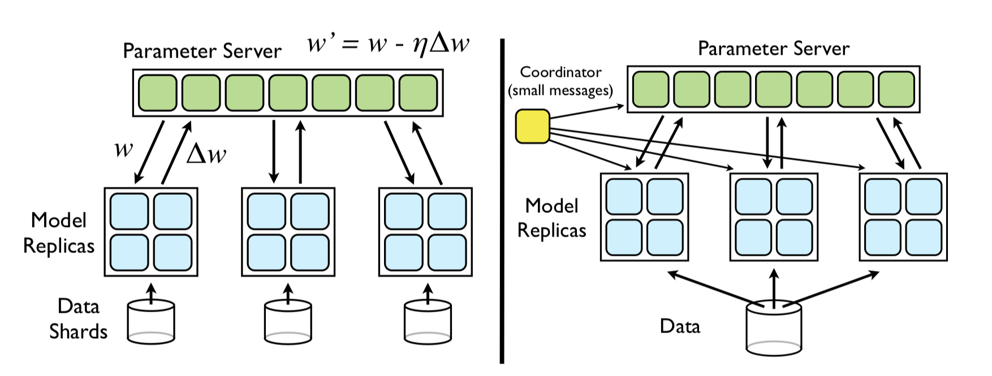
Context
Need for distributed training for Deep Learning
Parameter server abstractions were too general
Difficult to use
Theano not designed for distributed setting
DistBelief Framework

Slide 46
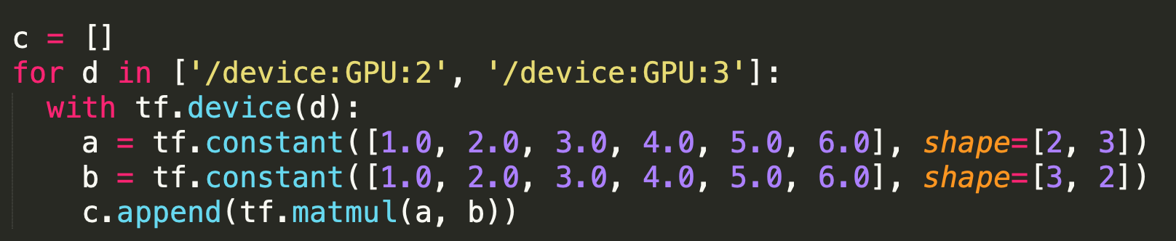
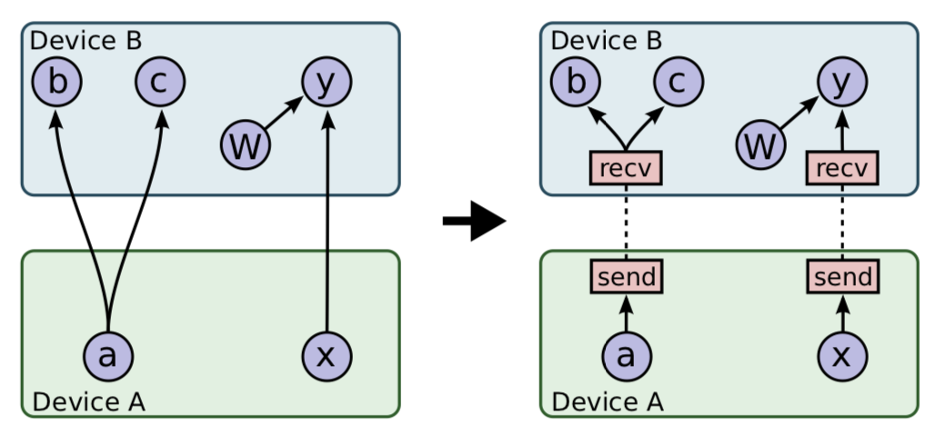
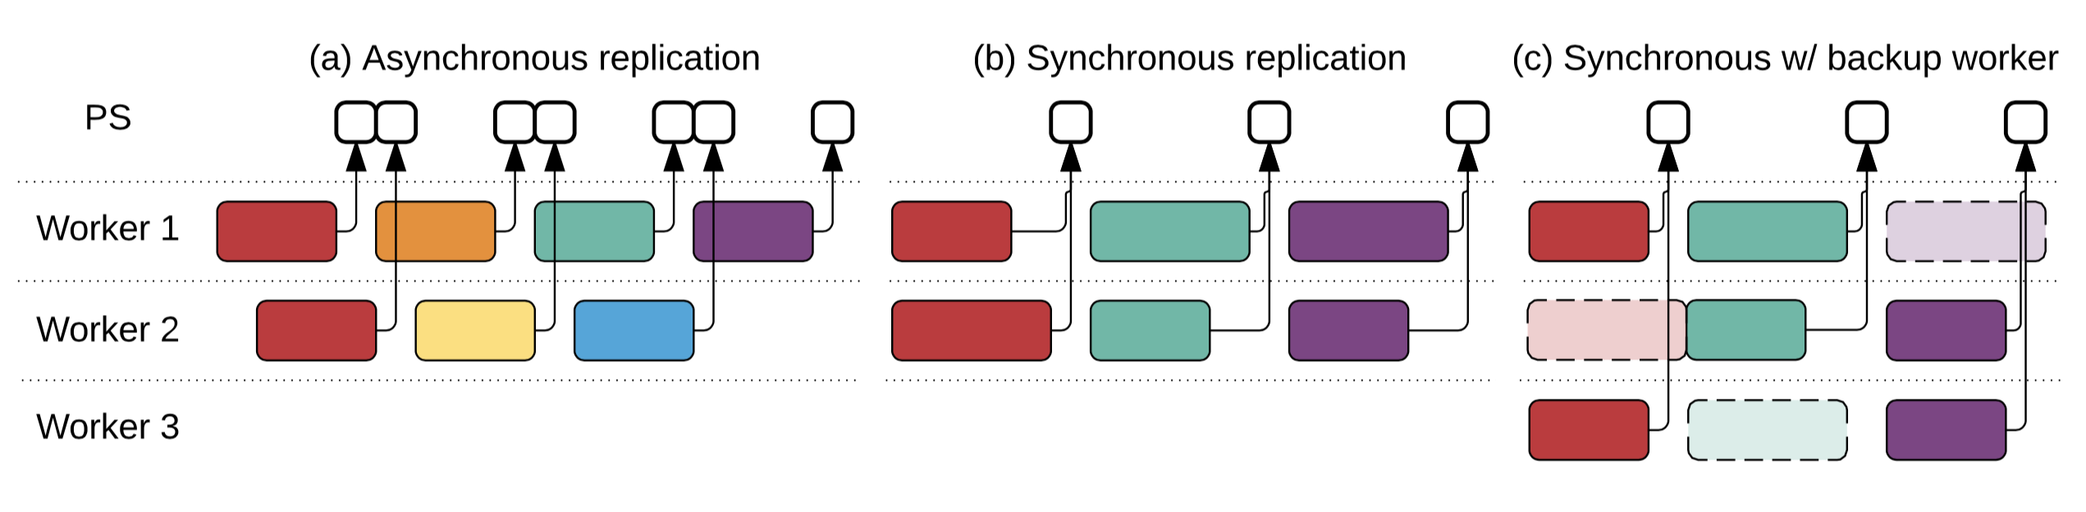
Big Ideas
Adopts a dataflow programming abstraction
Inspired by distributed data processing systems (@ google)
Resulting abstraction is very similar to Theano
Fine grained placement of operations on devices
Support multiple distributed concurrency protocols

Slide 47
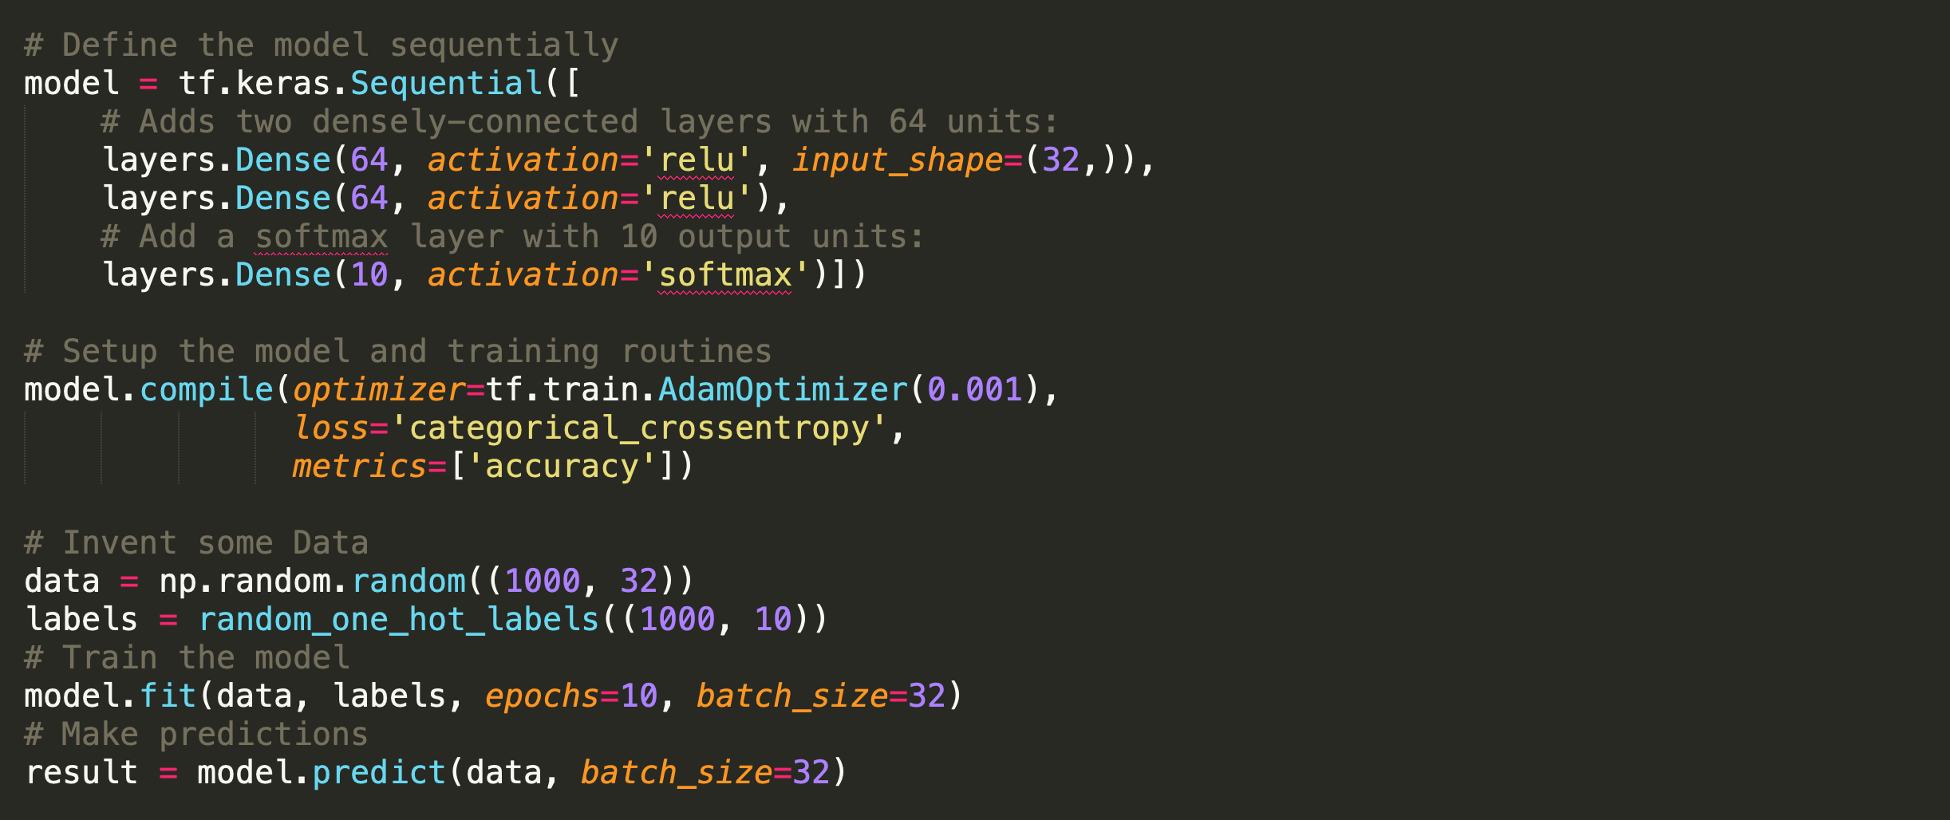
Recent advances in TensorFlow
Keras : high-level layer composition API

Slide 48
What to think about when reading
Relationship and comparisons to Theano?
Support for distributed computing and exposed abstraction?
What are the implications of design decisions on an Eager Execution
Additional Reading
TensorFlow: Large-Scale Machine Learning on Heterogeneous Distributed Systems

Slide 49
TVM
Tianqi et. al [OSDI’18]
*Currently visiting in the RISE Lab

Slide 50
TVM
Originally derived from Halide
Leverages similar IR and separation of algorithm from schedule
Focused on inference workloads

Slide 51
TVM
Originally derived from Halide
Leverages similar IR and separation of algorithm from schedule
Guess what this describes?

Slide 52
TVM
Enables declaring new hardware intrinsics
Simplifies adding support for new hardware

Slide 53
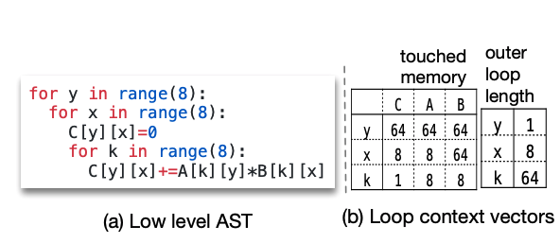
TVM
Learning based auto-tuner
Parametrized the AST
Use Gradient Boosted Trees (GBT) to optimize a “rank loss” to predict the relative order of program runtime

Slide 54
Done!

